Slide 1


SMART INDIA HACKATHON 2024
TITLE PAGE
Problem Statement ID – SIH 1556
Problem Statement Title - Develop a Smart Yoga Mat integrated with Artificial Intelligence (AI) capabilities to support smart watch integration for tracking progress and provide curated yoga content by experts, while ensuring its affordability.
Theme – Medtech / Biotech / Healthtech
PS Category- Hardware
Team ID- 3718
Team Name – TEAM G3N3SIS

Slide 2
AI Powered Smart Yoga-mat with Smart Watch integration
TEAM G3N3SIS
PROBLEM RESOLUTION:
Enables seamless connection with smartwatches for key metric tracking.
Provides personalized content like instructional videos and audio guidance with accurate posture corrections.
Remains cost-effective (5000 INR approx.) without compromising on quality or functionality
User-friendly interface and ergonomic design suitable for various yoga practices.
IDEA / SOLUTION :
A cost-effective, AI-powered smart yoga mat offering real-time feedback, posture analysis, and personalized routines via seamless smartwatch integration and a user-friendly mobile app
Calibratable yoga mat: Suitable for all body types and heights.
AI-Powered Posture Correction: Through LED indicators on the mat (show exact correction points) and through one-on-one instruction and feedback through user friendly NLP model
User-Friendly App: Leverages CV model and additional features like streaks, statistics, routine building, gamification, social sharing etc.
Unique Value Propositions (UVP) :
Advanced Posture Correction using LEDs and NLP model
The mat adapts to individual user limits through a detailed calibration process ( Inclusive of all body types and heights )
Comprehensive App Features: Our app includes streaks, routine building, gamification, and community-based feedback

Slide 3
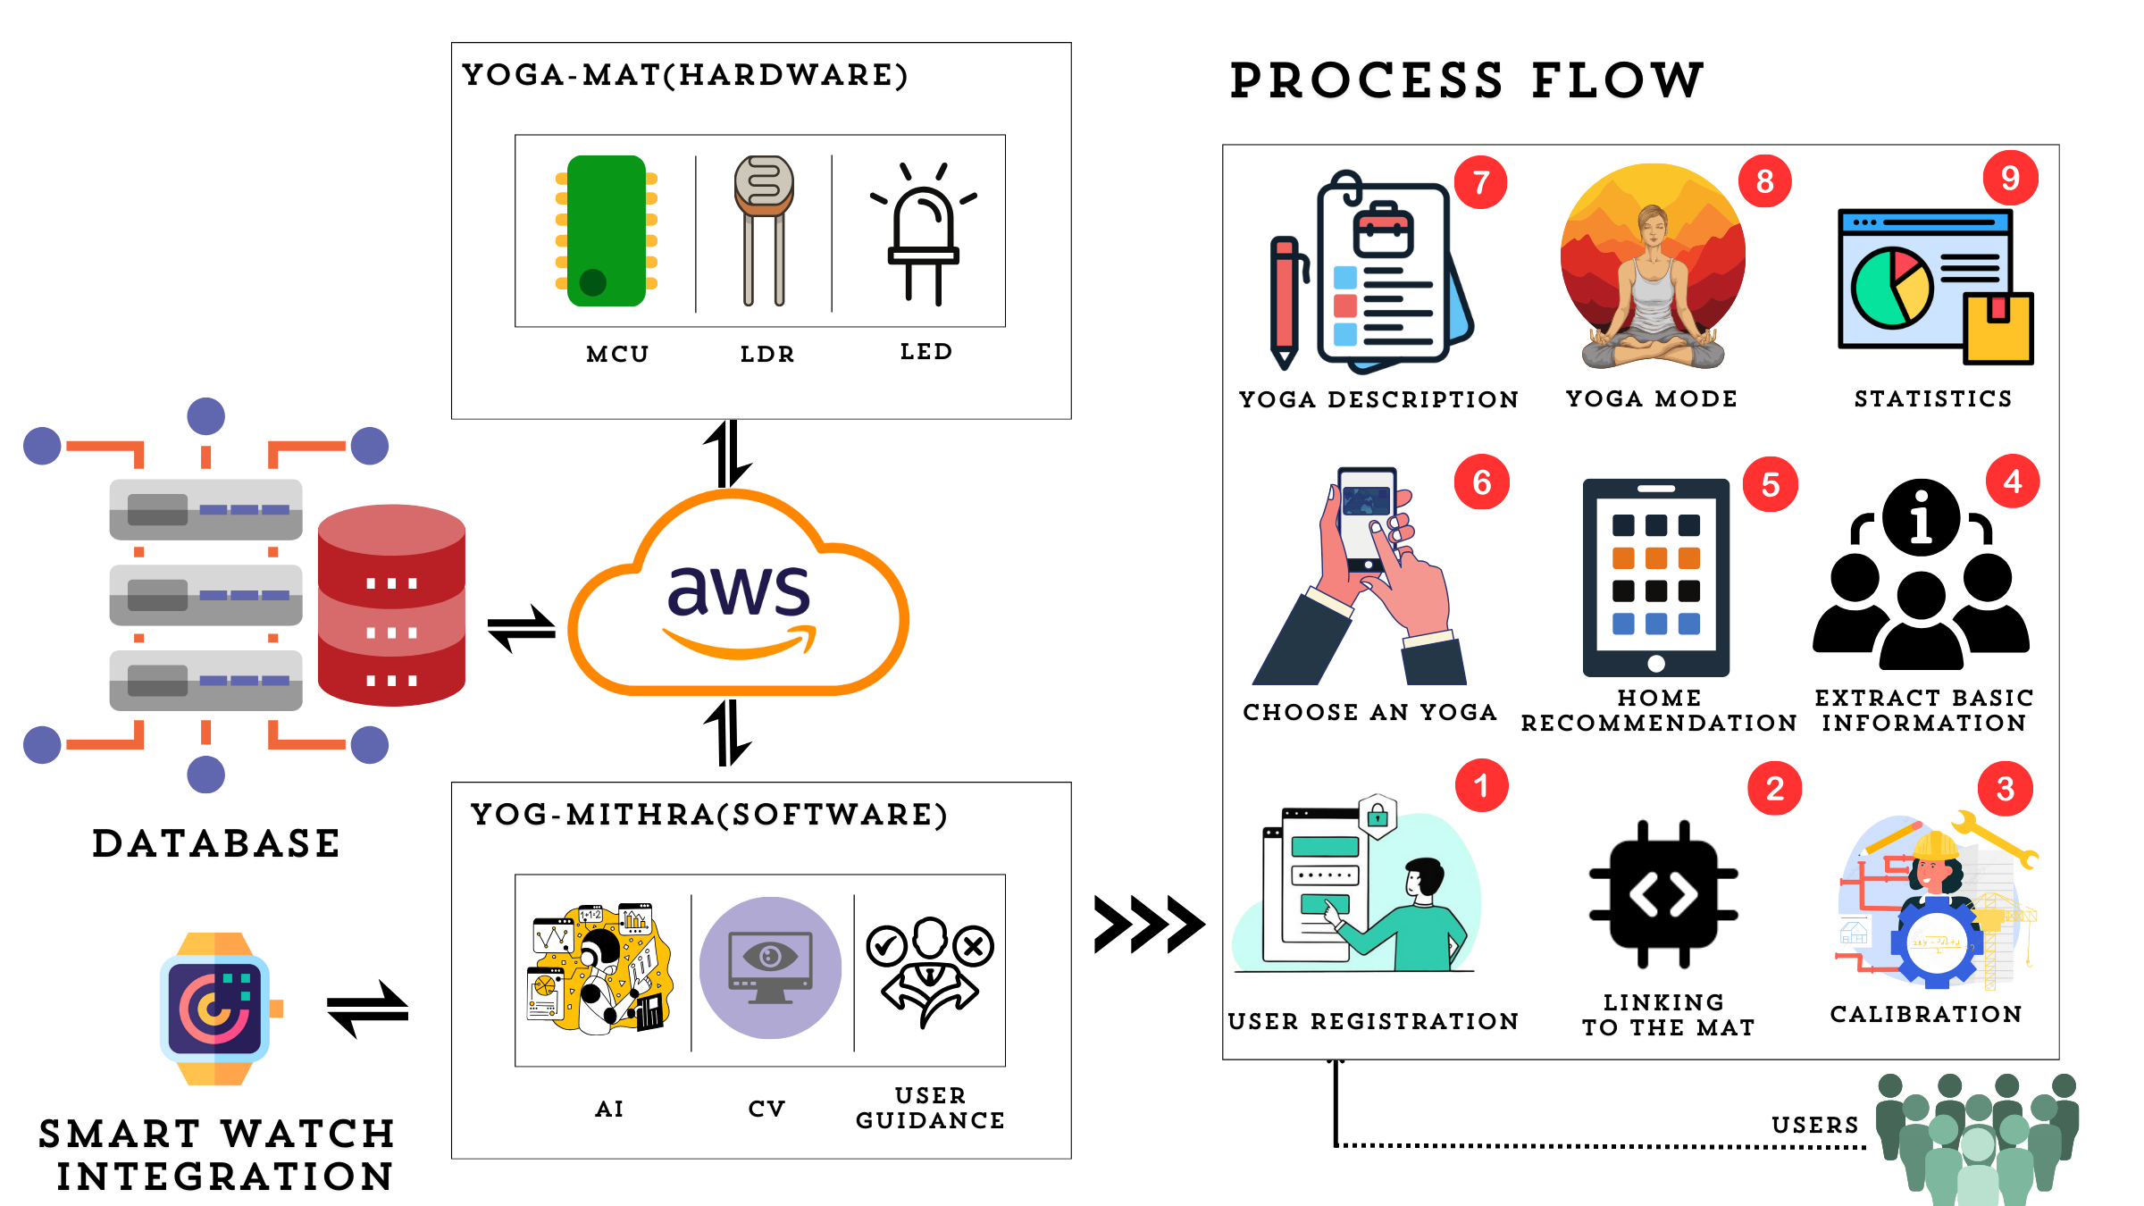
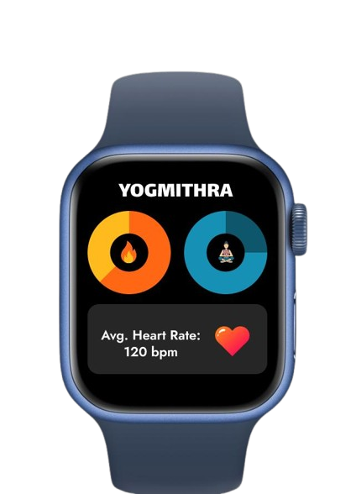
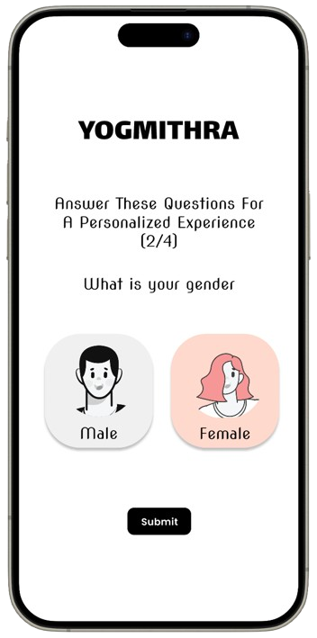
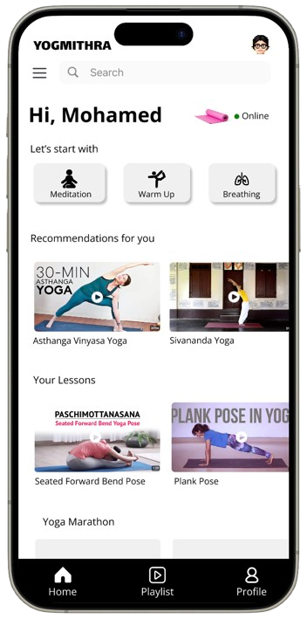
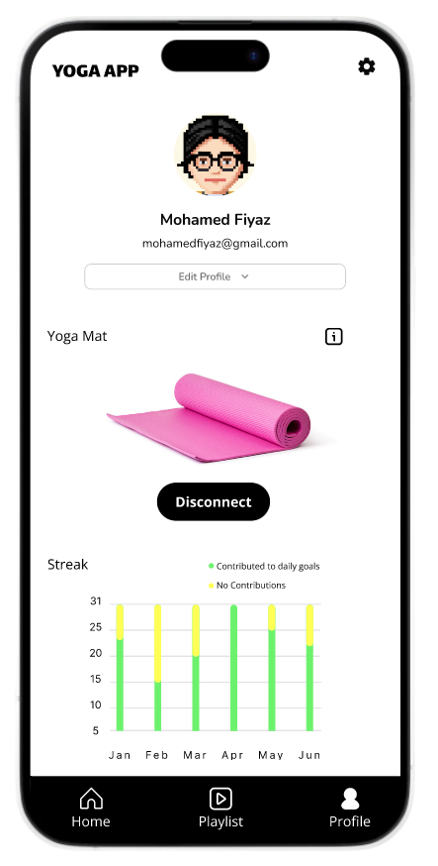
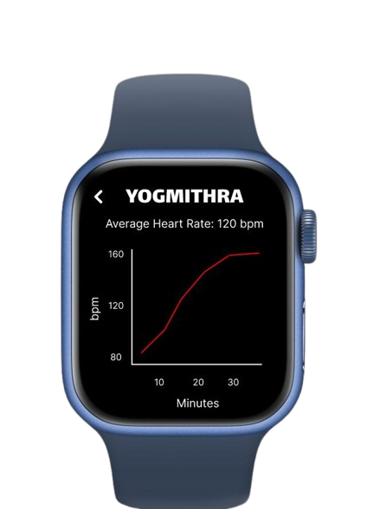
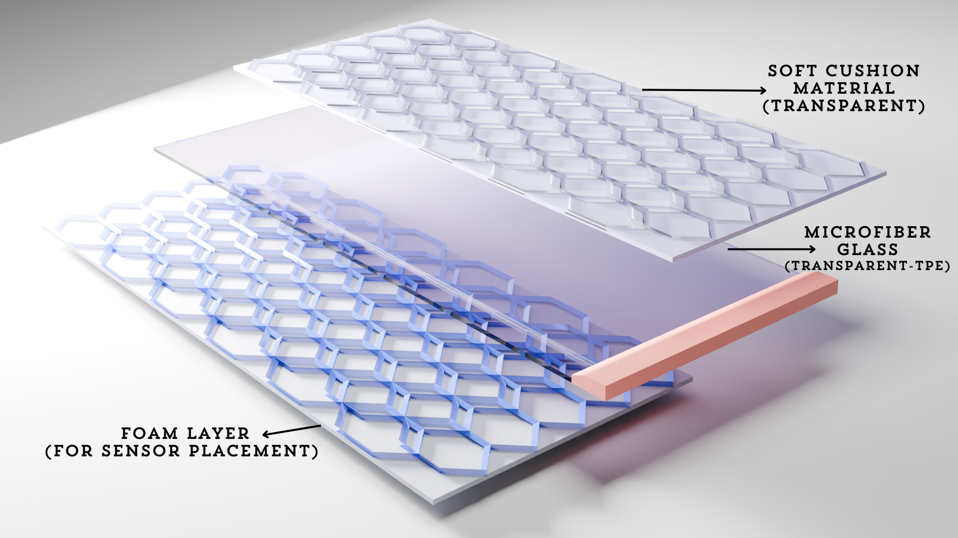
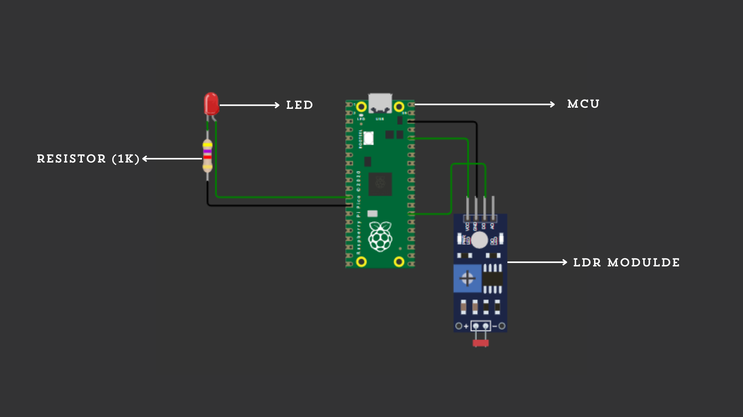








TECHNICAL APPROACH
TEAM G3N3SIS
FRONTEND
BACKEND
HARDWARE
Tech Stack:

Slide 4
FEASIBILITY AND VIABILITY
TEAM G3N3SIS
ANALYSIS OF FEASABILITY OF IDEA
MITIGATION STRATEGY
Built in Power Saving mode and also provided modular battery design allowing users to swap out fully recharged battery , users can also opt for power supply
This is just our initial prototype , for our next version we are going to embed the light and other sensors within the fabric using mems fabrication , thus ensuring portability
To minimize sensor malfunctions, we've implemented a modular design with a troubleshoot mode that pings LEDs and tests all sensors.
The app then identifies faulty modules, allowing users to purchase replacement parts from our website for self-repair or opt for professional support
Form a dedicated a team for software development and customer support
This is just our Technically feasible with LDR sensors , LEDs , AI and CV
Cost-effective, making it accessible to a broader market.
Scalable with available components and local manufacturing.
RISK/CHALLENGES:
Battery Capacity is low (2-3hrs)
Portability is less (still this is in prototype stage)
Sensory malfunction
Ensuring reliable and timely customer support/service
Curating and synchronizing new content for the users regularly and Regular software and Security updates

Slide 5
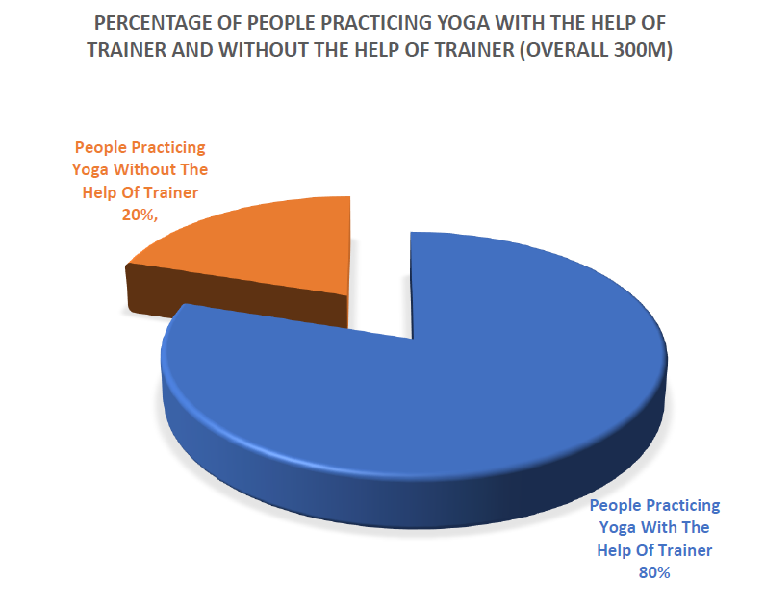
IMPACT AND BENEFITS
TEAM G3N3SIS
IMPACT ON TARGET AUDIENCE
Improves physical and mental health through personalized yoga guidance.
Increased accessibility to high-quality yoga education at an affordable price.
Enhanced user engagement through gamification, community features, and smart technology integration
POTENTIAL BENEFITS
Social: Promotes well being by encouraging a healthier lifestyle and building a supportive community through shared progress and goals
Economic: Potential to create thousands of jobs for laborers, yoga instructors, and IT specialists.
Environmental: Supports local manufacturing and eco-friendly practices, reducing the carbon footprint.

Slide 6
RESEARCH AND REFERENCES
TEAM G3N3SIS
REFERENCES
https://ieeexplore.ieee.org/abstract/document/8902371
https://ieeexplore.ieee.org/abstract/document/8902371
https://www.mdpi.com/2306-5354/10/4/459
https://yogifi.fit/?v=c86ee0d9d7ed
https://ieeexplore.ieee.org/abstract/document/9444325

Slide 7
IMPORTANT INSTRUCTIONS
Please ensure below pointers are met while submitting the Idea PPT:
Kindly keep the maximum slides limit up to six (6). ( Including the title slide)
Try to avoid paragraphs and post your idea in points /diagrams / Infographics /pictures
Keep your explanation precise and easy to understand
Idea should be unique and novel.
You can only use provided template for making the PPT without changing the idea details pointers (mentioned in previous slides).
You need to save the file in PDF and upload the same on portal. No PPT, Word Doc or any other format will be supported.
Note - You can delete this slide (Important Pointers) when you upload the details of your idea on SIH portal.

